Slide 1



Digital Classroom
Course category
Bringing digital literacy to every space, for all and
for anybody.
Start Course

Slide 2

Course Objectives
01
Learners will be able to identify some digital tools used in their daily life.
02
Tools learnt by learners will help learners be effective and productive in their life.
03
You’ll learn to avoid repeating common mistakes professionals face.
04
Learners will acquire digital literacy skills in using basic to complex digital tools .

Slide 3

Digital Literacy
CHAPTER 1
This refers to an individual’s ability to find, evaluate, and communicate information through typing and other media on various digital platforms.
Computers have are enhancing and have improved the way we work, teach, learn and have become somewhat a basic thing in our daily endeavor.
Talk to your school’s IT department about the tools you can use to digitize the classroom.

Slide 4
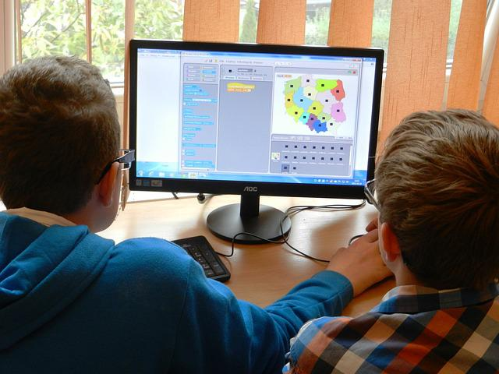

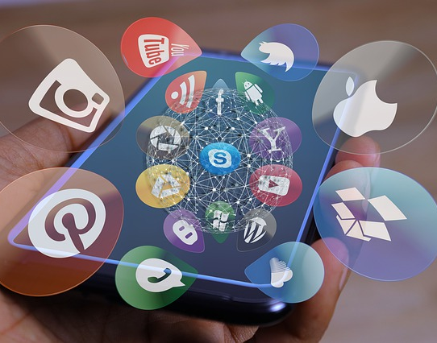
Digital Tools
CHAPTER 2
Google Classroom
Computers
Apps
Google classroom has a suite of products that can help you digitize your classroom.
This suite includes Google forms, YouTube, Google Docs, Google Sheets etc. These tools are integrated into your Google classroom.
Computers and other mobile devices can be introduced in the classroom.
Though they are expensive, having these devices with the necessary educational tools installed would make education more interactive and fun.
The use of educational apps is a key to adding effective interactivity to your classroom.
Infusing apps like Socrative, Mavis Beacon, and the likes can enhance students participation in the classroom.

Slide 5

Importance
CHAPTER 4
Enhances collaboration and team building.
It prepares students for the future of work.
Students get to know how to use digital tools to solve societal problems.
Students have the ability to search the web for solutions.

Slide 6
Summary
Takeaway 1
Advance courses
In this brief course, you learned about Some digital tools to digitize your classroom .
Kindly check out my advanced course here.
Takeaway 2
Takeaway 3
Students learnt about some apps to make classroom very interactive.
Students get to know the importance of digital literacy.

Slide 7

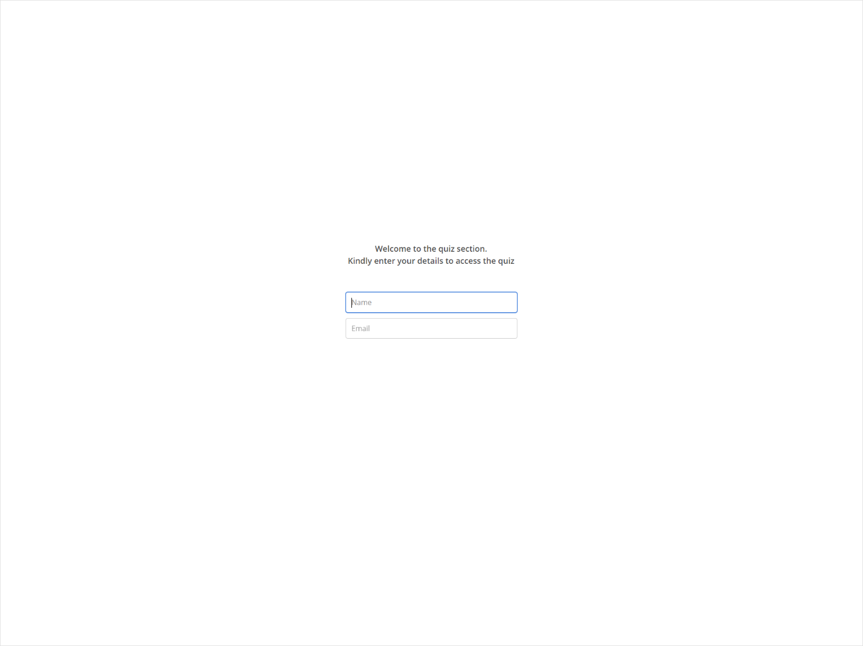
Quiz
Click the Quiz button to edit this object

